Slide 2
Presentation Outline
Title
Background
Problem Statement
Main objective & Specific objectives
Literature review
Methodology
Expected outcomes
Planned Activities
Time Plan
Budget.
Notes:
10/9/2024
1

Slide 3
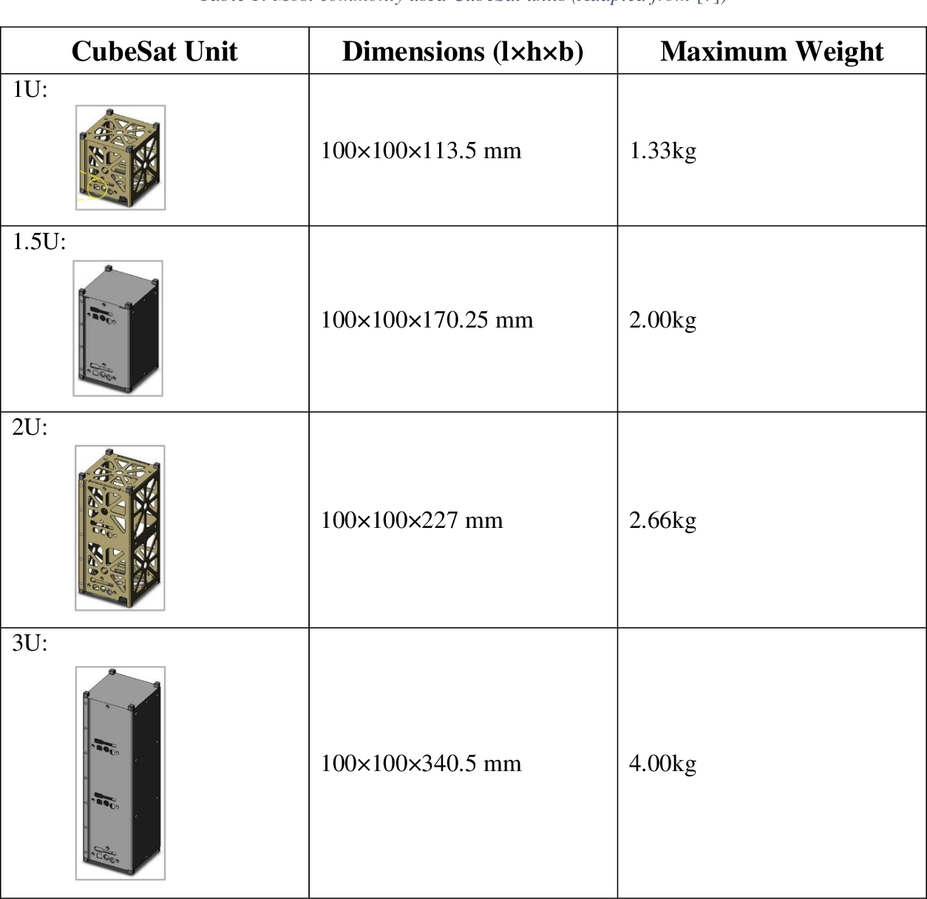
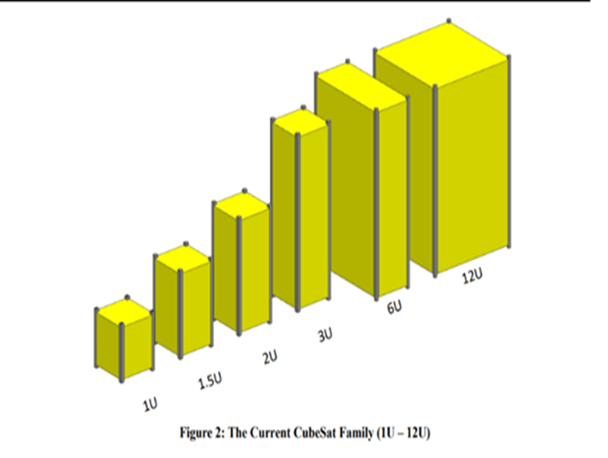
Introduction & Background
Dimension constraints.
Mass constraints
Space considerations
Altitude control.
Maximum power production.
Notes:
10/9/2024
2
Design of the structure of a satellite are heavily guided by parameters and specifications set by NASA that is used worldwide. The dimension and weight of the cube sat ranges from a 1U (10x10x11.3cm volume and weight of 2Kg to a 12U (226.3 x 226.3x 366.0cm) volume and a weight of 24Kg. For maximum power output and steady altitude control in space, there is need for the solar panels in the satellite to be deployable

Slide 4
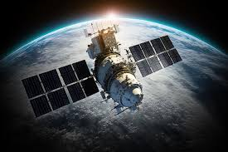
Problem statement
Reasons for solar panel deployment.
Power generation needs
Reliability and failure mitigation.
Solar panel surface area constraints.
Challenges in CubeSat solar panel deployment
Vague documentation of current deployment systems.
Sizes and mass constraints.
Inadequate control features.
https://spaceplace.nasa.gov/satellite/en/
Notes:
The current solar panel deployers of a satellite have vague documentation on how they are designed, fabricated and operated. Research shows that the current solar panel deployers are unique to the type and size of CubeSat and it's usually CubeSats bigger than 3U where size is not a limiting factor. The deployers used in smaller satellites are also traditional such that there is no control factor in the mechanisms
Solar panels are a common point of failure in CubeSat missions; thus, developing reliable deployment mechanisms is crucial. Innovations in deployment systems aim to minimize failure rates associated with solar arrays, ensuring that they deploy correctly and function as intended once in orbit

Slide 5
Research Objectives
Main Objective
The main objective of this study is to develop a solar panel deployment mechanism that will be integrated to 3U CubeSats without compromising on the space. Strength and mass of the structure.
Specific Objectives
Assess the current solar panels deployment mechanisms produced and find their mechanical properties such as: dimensions, size, mass and material.
Investigate the limitations on the existing solar panel deployment systems.
Develop a potential solar panel deployment mechanism that can overcomes the limitations of the existing solar panel deployment systems.
Test and evaluate the advanced mechanism.

Slide 6
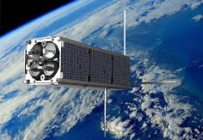
Literature Review: Overview
CubeSat are used in low-Earth orbit for applications such as remote sensing, space weather measurements and communications
Size and mass of CubeSat allows:
lots of launch opportunities.
low launch cost.
Solar panels deployment enables:
Increased efficiency of solar energy intake
Deployment failsafe features
https://spaceplace.nasa.gov/satellite/en/
[http://www.iea.org/]
[http://www.effectofglobalwarming.com/]
https://www.geoscan.ru/en/blog/russia-completes-first-national-successful-cubesat-thruster-trials
Notes:
CubeSats are typically built up from standard cubic units each measuring 10 cm x 10 cm x 10 cm – just a bit bigger than a Rubik’s cube! The number of units depends on the CubeSat’s mission, but tends to be between 2 and 16, resulting in a mass of just 3–32 kg. These little satellites have a fraction of the mass, and cost, of more traditional satellites.
CubeSats tend to hitch a ride into space using extra space available on rockets, meaning lots of launch opportunities and low launch costs. They are packed in a standard-sized container which, at the push of a button, ejects them into space via a spring system. A similar technique is used to deploy CubeSats from the International Space Station (ISS), where they are launched out of the Japanese module, Kibo.

Slide 7
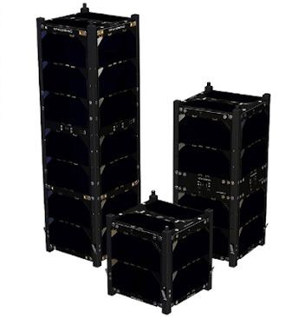
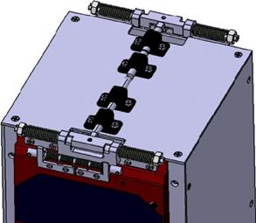
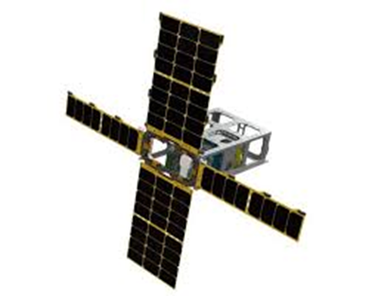
Literature Review.
Types | Design | Author/ Manufacturer | Working Principle | Advantage | Limitations
Non deployable solar array. |  | ISISSpace Spacemind tech UCL Edurosat (Launched) | The panels are attached at the side of the CubeSat | Simple Cheap; no components involved Mass, size, structure balance | Applicable on sizes of 3U and below. Limited sun coverage, thus limited power supply.
Lateral Top hinged solar array |  | Alen space Inc Edurosat Inc. Pumpkin Inc. (Launched) | Use of springs, and hinges panel under tension in the rocket, tension released after deployment | Relatively simple Relatively cheap. Increased sun coverage, thus increased power supply. | UnpredictableEffect on Axis alignment. Limited control. A prone point of failure.

Slide 8
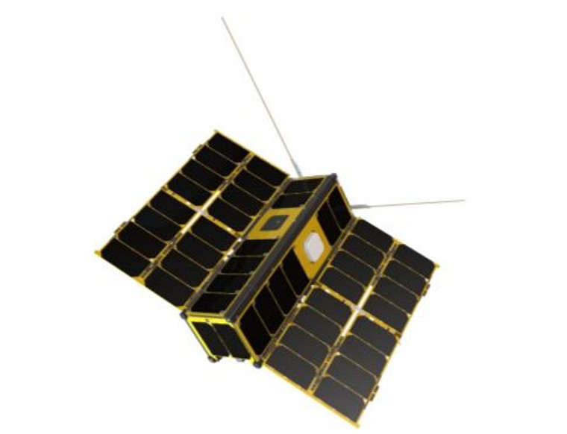
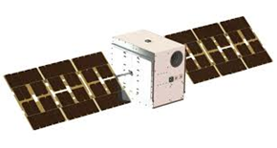
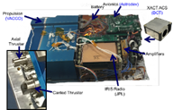
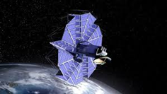
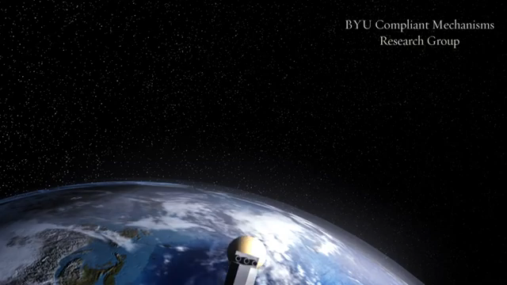
Literature review.
Type | Design | Author/ Manufacturer | Working Principle | Advantages | Disadvantages
Lateral side hinged solar array |  | Edurosat Pumpkin inc. ISISSpace UCL (Launched) | Use of hinges and springs but connected on the side. | Relatively simple Relatively cheap It has a relatively small effect on axis alignment. | Limited control Unpredictable effect on axis Prone failure point
Steerable Solar arrays |  | Marco A Marco B PTD-O Kepler (Launched) | Use of thrusters | Control features Real time data retrieval on axis Failsafe features | Expensive Used on 6U CubeSats and higher.
Origami Joint solar array |  | Brighton Young University (ongoing R&D) James web telescope (launched) |  | Saves on space Relatively light Maximum power intake. | Ongoing research unknown
https://youtu.be/3E12uju1vgQ

Slide 9
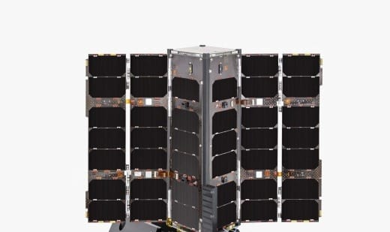
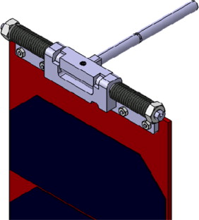
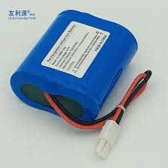
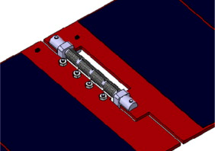
Methodology: Overview.
Mechanical Subsystem
Body frame
Spring deployment mechanism.
Reaction wheel.
2. Electrical Subsystem
Power management system
Battery management system
3. Control subsystem.
Real time data and control features on deployment and position axis.
Notes:
3U Satellite’s specifications.
Dimension constraints.
Mass constraints
Space considerations
Altitude control.
Maximum power production

Slide 10
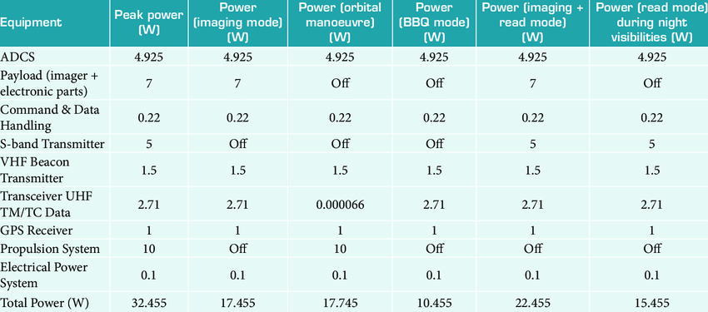
Methodology: Steps in calculating the power budget
Assumptions:
The 3U satellite will be a Low Earth Orbit of 300km above earth’s surface.
Orbital period = 90 minutes.
Maximum power consumption is 20-30W.
The power budget is a representation of the Quakesat 3U that was launched by Stanford Uni in 2003.

Slide 11
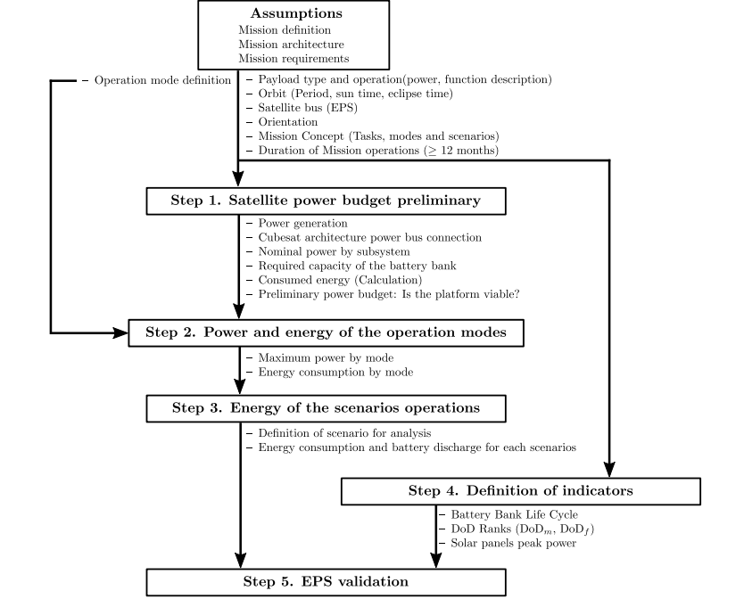
A_Method_for_Validating_CubeSat_Satellite_EPS_Through_Power_Budget_Analysis_Aligned_With_Mission_Requirements (IEEE Access)

Slide 12
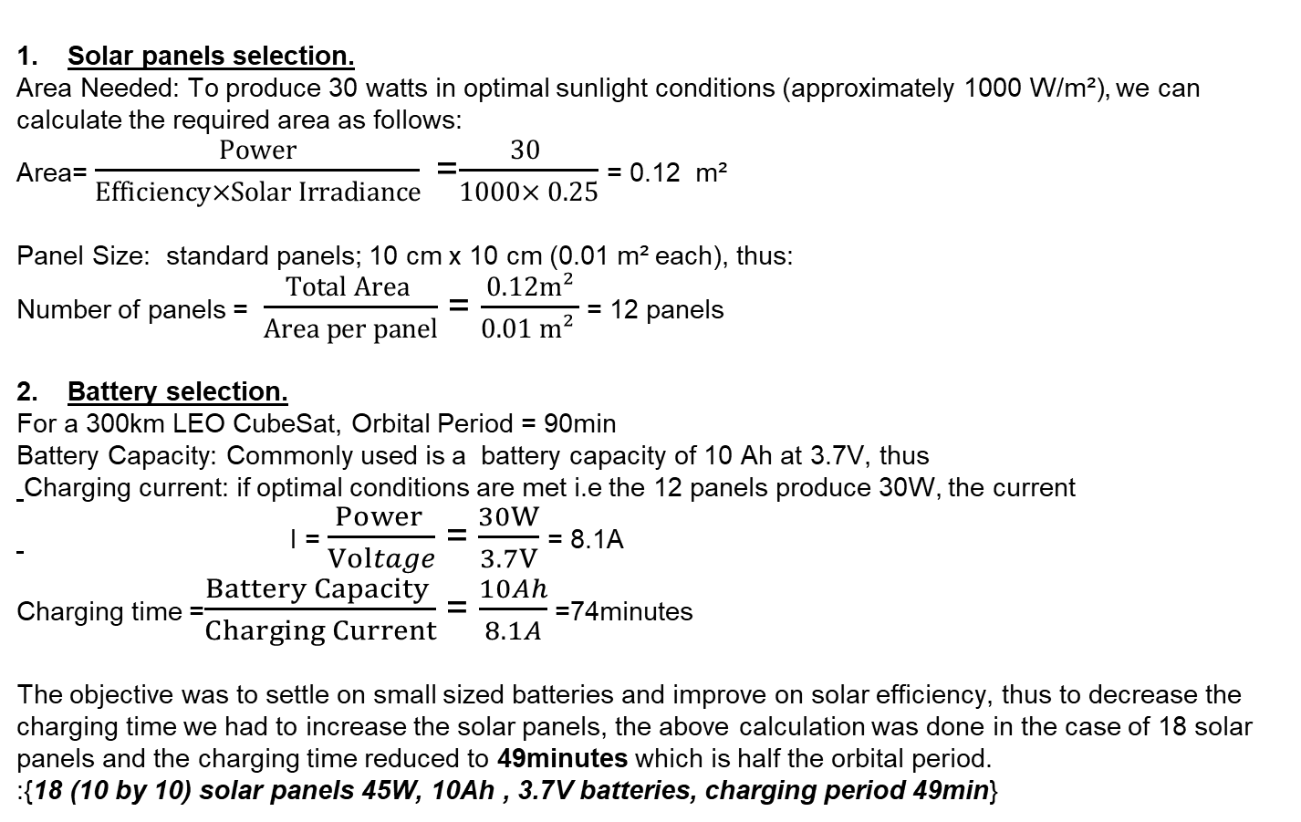
Methodology: Power budget.
Solar panels selection.
Area Needed: To produce 30 watts in optimal sunlight conditions (approximately 1000 W/m²), we can calculate the required area as follows:
Area= $\frac{Power}{Efficiency×Solar Irradiance}$=$\frac{30 }{1000× 0.25}$= 0.12 m²
Panel Size: standard panels; 10 cm x 10 cm (0.01 m² each), thus:
Number of panels = $\frac{Total Area }{Area per panel}$ = $\frac{0.12m²}{0.01 m² }$ = 12 panels
Battery selection.
For a 300km LEO CubeSat, Orbital Period = 90min
Battery Capacity: Commonly used is a battery capacity of 10 Ah at 3.7V, thus
Charging current: if optimal conditions are met i.e the 12 panels produce 30W, the current
I = $\frac{Power }{Voltage}$ = $\frac{30W}{3.7V}$= 8.1A
Charging time =$\frac{Battery Capacity }{Charging Current}$ = $\frac{10Ah}{8.1A}$ =74minutes
The objective was to settle on small sized batteries and improve on solar efficiency, thus to decrease the charging time we had to increase the solar panels, the above calculation was done in the case of 18 solar panels and the charging time reduced to 49minutes which is half the orbital period.
:{18 (10 by 10) solar panels 45W, 10Ah , 3.7V batteries, charging period 49min}

Slide 13
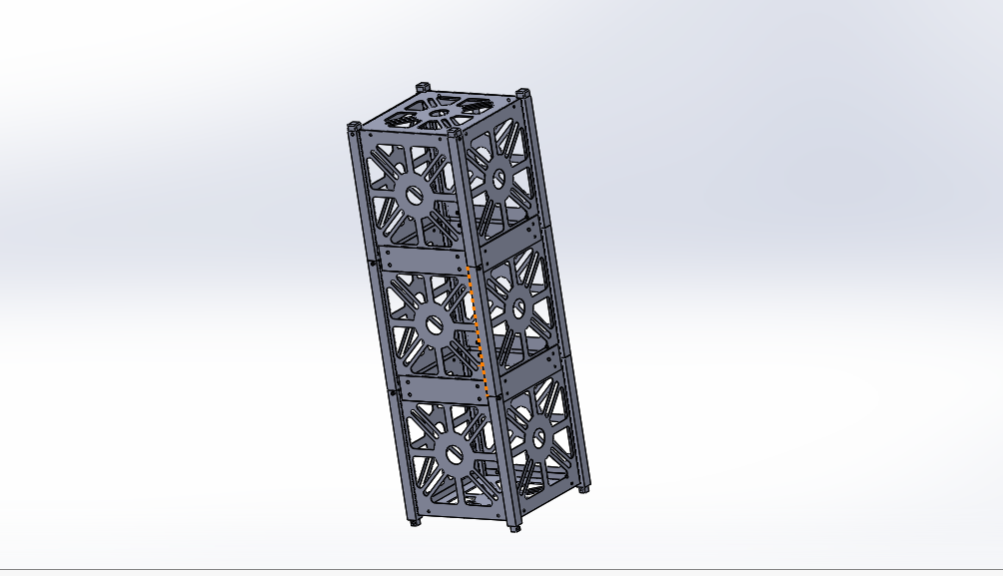
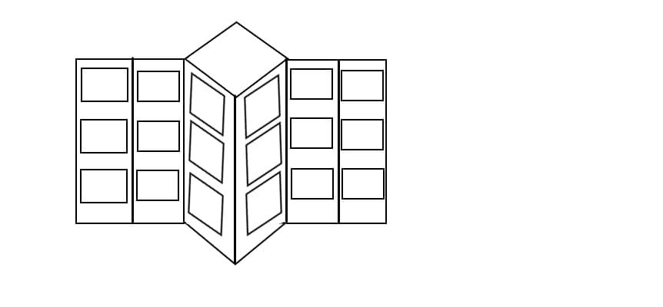
Methodology: Sketch

Slide 14
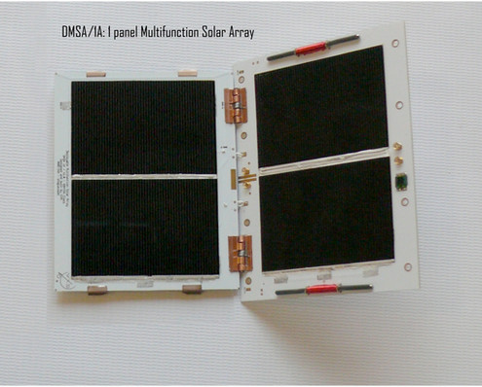
Planned activities.
Extensive research on deployment mechanisms
CAD/CAM design on deployment mechanism
3U CubeSat design
Reaction wheel design
Body frame with hinge mechanism.
Static simulation and mass analysis
Thermal analysis
Dynamic simulation; Effect on C.O.G, axis alignment.
Electrical & electronics design.
Subsystem assembly and computation
Electrical & electronic simulation
Design evaluation and approval
Final Interim Report.
Fabrication
Testing
Presentation

Slide 15
Expected Outcomes
The anticipated outcome of this research are:
A perfectly timed Solar panel deployment system.
Increased solar energy absorption rate.
Stable and controlled axis alignment and COG.
A high max power load capacity.
Safety compliance.

Slide 16
Time plan.

Slide 17
Budget.
Component | Quantity | Cost
Battery | 4 | N/A
Battery management system | 1 | N/A
Solar panel | 40 | N/A
Spring deployment mechanism | 4 | N/A
Motor | 4 | N/A
Body frame | 1 | N/A
Gyroscope | 1 | N/A
Microcontroller | 1 | N/A
TOTAL |  | N/A

Slide 18
Thank you for your attention.

